Slide 1
Emergency Procedures

Slide 2
When injuries occur, while generally not life-threatening, they require prompt care
Emergencies are unexpected occurrences that require immediate attention - time is a factor
  First hour (“Golden hour”) is critical
Mistakes in initial injury management can prolong the length of time required for rehabilitation or cause life-threatening situations to arise

Slide 3
Emergency Action Plan
Primary concern is maintaining cardiovascular and CNS functioning
Key to emergency aid is the initial evaluation of the injured patient
Must have a prearranged plan that can be implemented on moments an emergency is notice

Slide 4
Issues plan should address
  Separate plans should be developed for each facility
    Outline personnel and role
    Identify necessary equipment
  Established equipment and helmet removal policies and procedures
  Availability of phones and access to 911
    Be aware of communication, transportation, treatment policies

Slide 5
  Community based care (continued)
    Individual calling medical personnel must relay the following: 1) type of emergency 2) suspected injury 3) present condition 4) current assistance 5) location of phone being used 6) location of emergency and 7) building limitations
  Keys to gates/locks must be easily accessible
  Key facility administrators must be aware of emergency action plans and be aware of specific roles – should be rehearsed
  Individual should be assigned to accompany patient to hospital

Slide 6
Principles of Injury Assessment
Appropriate acute care cannot be provided without a systematic assessment occurring on the playing field first
On-field assessment
  Determine nature of injury
  Provides information regarding direction of treatment
  Divided into primary and secondary survey

Slide 7
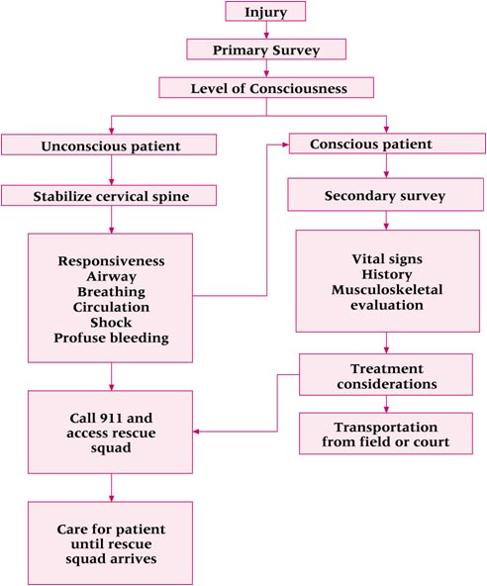
Figure 12-1

Slide 8
Primary survey
  Performed initially to establish presence of life-threatening condition
  Airway, breathing, circulation, shock and severe bleeding
  Used to correct life-threatening conditions
Secondary survey
  Life-threatening condition ruled out
  Gather specific information about injury
  Assess vital signs and perform more detailed evaluation of conditions that do not pose life-threatening consequences

Slide 9
Primary Survey
Life threatening injuries take precedents
  Those injuries requiring cardiopulmonary resuscitation, profuse bleeding and shock
  Level of consciousness must also be assessed
Emergency Cardiopulmonary Resuscitation
  Evaluate to determine need
  Should be certified through American Heart Association, American Red Cross or National Safety Council

Slide 10
Dealing with Unconscious Patient
Provides great dilemma relative to treatment
Must be considered to have life-threatening condition
  Note body position and level of consciousness
  Check and establish airway, breathing, circulation (ABC)
  Assume neck and spine injury
  Remove helmet only after neck and spine injury is ruled out (facemask removal will be required in the event of CPR)

Slide 11
  With patient supine and not breathing, ABC’s should be established immediately
  If patient unconscious and breathing, nothing should be done until consciousness resumes
  If prone and not breathing, log roll and begin CPR immediately
  If prone and breathing, nothing should be done until consciousness resumes --then carefully log roll and continue to monitor ABC’s
  Life support should be monitored and maintained until emergency personnel arrive
  Once stabilized, a secondary survey should be performed

Slide 12
Overview of Emergency Cardiopulmonary Resuscitation
A careful evaluation should be performed to determine if CPR is necessary
Individuals should be certified/recertified routinely in CPR
  American Heart Association, American Red Cross, National Safety Council

Slide 13
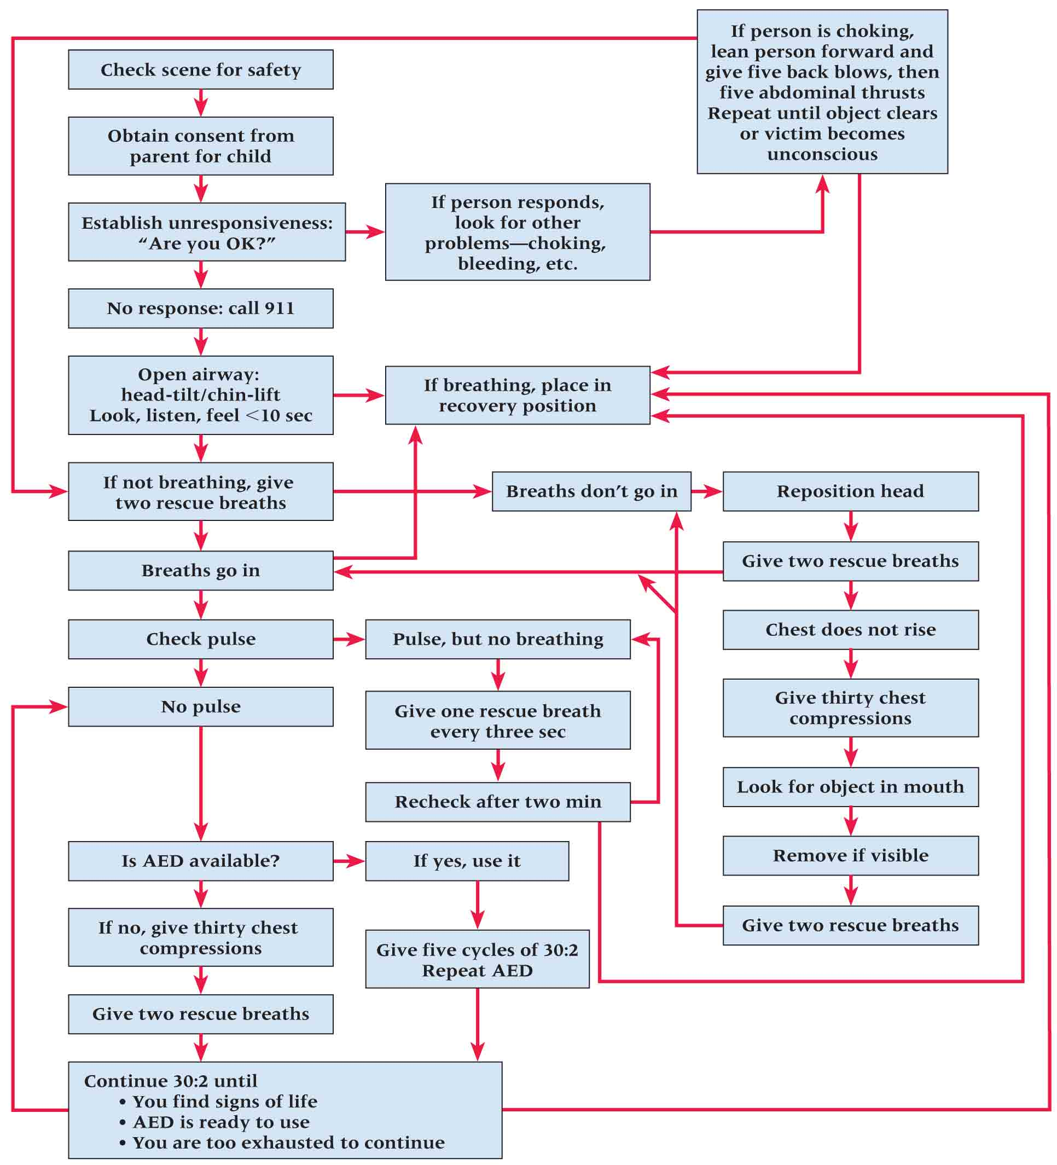
Check-Call-Care
  Check the scene; identify others to assist
  Call EMS
  Care should be initiated
  Time is critical for the patient needing CPR

Slide 14
Equipment Considerations
  Equipment may compromise lifesaving efforts but removal may compromise situation further
  Facemask should be removed
  Use of pocket mask/barrier mandated by OSHA during CPR to avoid exposure to bloodborne pathogens
  helmet must either both come off or both remain in place
  Removal should occur if:
    1) Head is not secure, 2) airway can’t be controlled, 3) facemask can’t be removed in reasonable amount of time, 4)helmet prevents immobilization

Slide 15
Establish Unresponsiveness
  Ask casualty “Are you okay?” and gently tap
  If no response, EMS should be activated and positioning of body should be noted and adjusted in the event CPR is necessary
  A patient that is breathing in a prone or side lying position should be placed in a recovery position
  If in a position other than supine the patient should be carefully log rolled as a unit to limit cervical motion

Slide 16
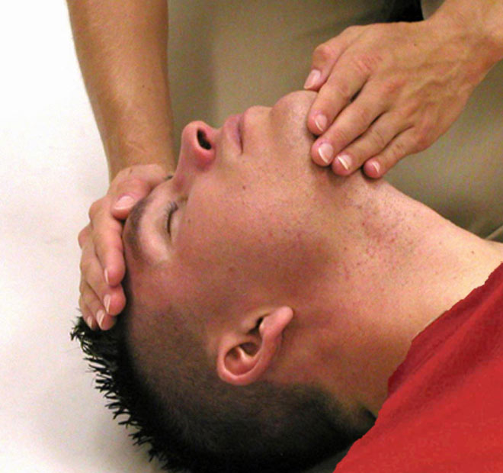
Opening the Airway
Head-tilt, chin lift method
Push down on the forehead and lifting the jaw moves the tongue from the back of the throat
Figure 12-7A

Slide 17
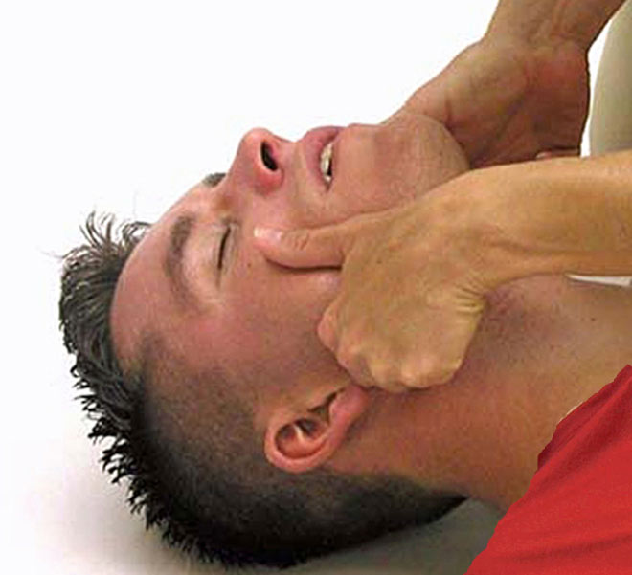
Modified technique can be used when neck injury is suspected
Modified jaw thrust maneuver
Not always effective and should be utilized by trained personnel
Figure 12-7B

Slide 18
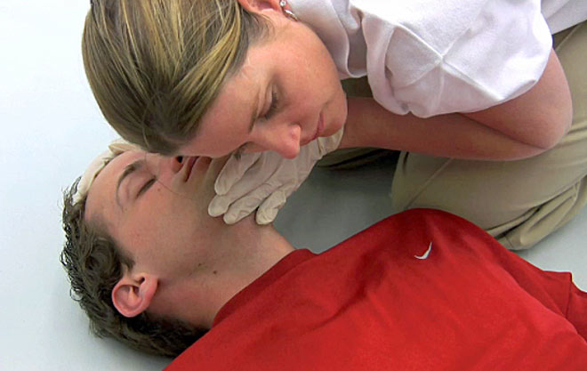
Establishing Breathing
Look, listen and feel
While maintaining pressure on forehead, pinch nose, hold head back
OSHA has mandated use of barrier shield by AT’s to minimize transmission of bloodborne pathogens
Figure 12-8
Take deep breath, and create seal around lips
and perform 2 slow breaths (raise chest 1.5 - 2”)

Slide 19
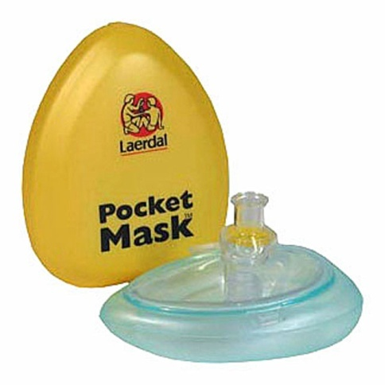
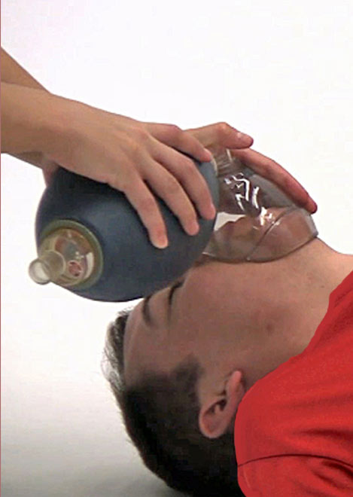
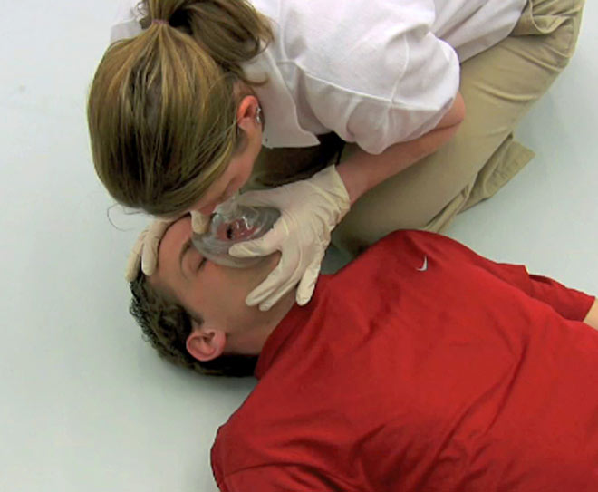
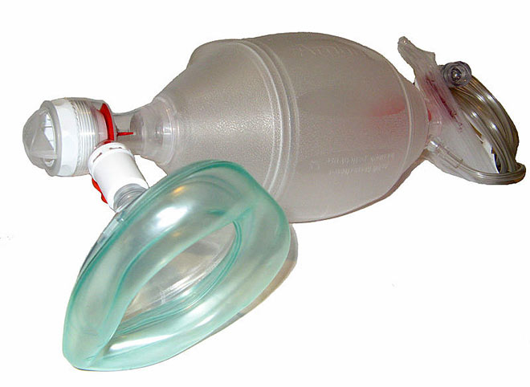
If breath does not go in, re-tilt and ventilate
If airway continues to be obstructed, perform 30 chest compression and look for object
Repeat until ventilation occurs
If available, use bag/valve mask for respiration
Figure 12-9

Slide 20
Administering Supplemental Oxygen
May prove to be critical in treating severe injury or illness
Requires the use of bag-valve mask and pressurized container of oxygen
Canister is green with yellow oxygen label
Training is required
Provides patient with a significantly high concentration of oxygen (up to 90%)
Deliver at a rate of 10-15 liters/minute

Slide 21
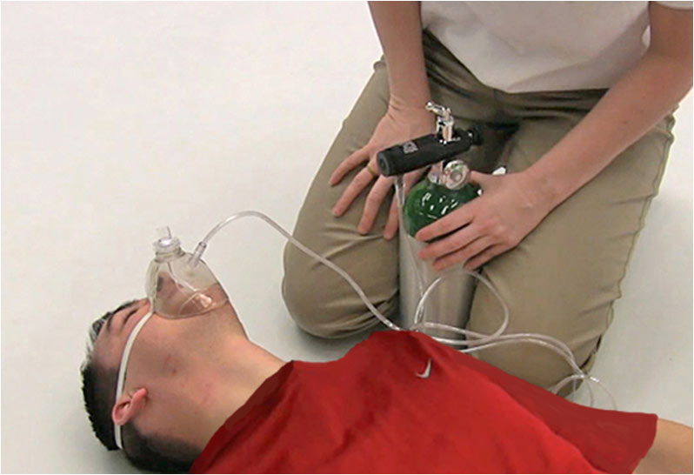
Figure 12-10

Slide 22
Establishing Circulation
Locate carotid artery and palpate pulse while maintaining head tilt position
If available, the AED should be used ASAP
If no AED is available and there are no signs of circulation chest compressions should be given after 2 rescue breaths
Maintain an open airway
Place heel of hand, closest to head on sternum between the nipples

Slide 23
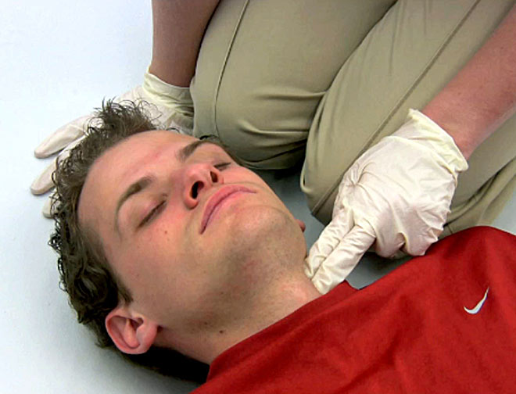
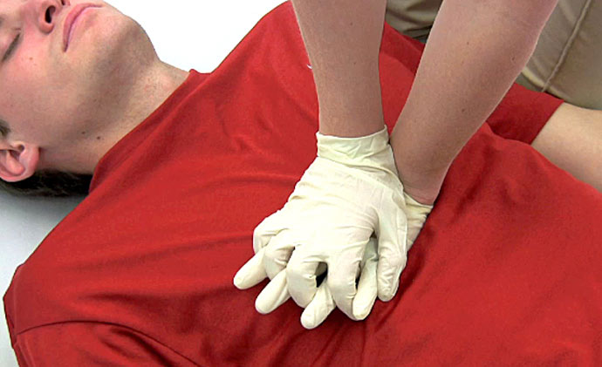
Place other hand on top with fingers parallel
Keep elbows locked with shoulders directly above patient
Compress chest 1.5-2” (30 times per 2 breaths)
After 5 cycles reassess pulse (if not present continue)
Figure 12-11 & 12

Slide 24
Compressions should occur at a rate of 100 per minute
In children, compressions should occur to depth of 1 – 1.5”
In 2008, American Heart Association proposed Hands-Only CPR in instances where individual collapses unexpectedly, is unresponsive and is not breathing
  Rescuer calls 911 and begins compressions
  Continues until rescuers with AED arrive

Slide 25
Using an Automatic External Defibrillator (AED)
Device that evaluates heart rhythms of victims experiencing cardiac arrest
Can deliver electrical charge to the heart
Fully automated - minimal training required
Maintenance is minimal for unit
True public access defibrillation
  Anyone with knowledge of AED can utilize
  Some states require formal training, in others individuals can utilize AED in good faith attempt to save life of victim in cardiac arrest

Slide 26
New AED’s are coming out that will enable trained lay rescuers to help save lives
Most can be trained to use AED in an hour
Requires trained individual to follow instructions regarding breaths and chest compression
Electrodes are placed at the left apex and right base of chest - when turned on, machine indicates if and when defibrillation necessary
Patient should not be on metal or wet surface during use

Slide 27
Obstructed Airway Management
Choking is a possibility in many activities
Mouth pieces, broken dental work, tongue, gum, blood clots from head and facial trauma, and vomit can obstruct the airway
When obstructed individual cannot breath, speak, or cough and they may become cyanotic

Slide 28
If patient becomes unconscious, open airway and attempt to ventilate.
If airway remains obstructed, re-tilt and re-ventilate
If ventilation fails, perform 30 chest compressions and finger sweep to clear obstruction
  Be sure not to push object in further with sweep
Repeat cycle until air goes in
When athlete begins to breath on own, place in comfortable recovery position while lying on their side

Slide 29
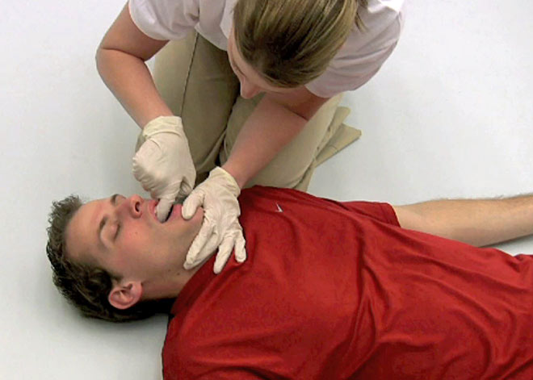
Index finger should be inserted in mouth along cheek
Using hooking maneuver, pull across to free impediment
Attempt to ventilate after each sweep until patient is breathing
Figure 12-15

Slide 30
Moving and Transporting
Injured Patient
Must be executed with techniques that will not result in additional injury
No excuse for poor handling
Planning is necessary and practice is essential
Additional equipment may be required

Slide 31
Placing Patient on Spine Board
  EMS should be contacted if this will be required
  Must maintain head and neck in alignment of long axis of the body
  One person must be responsible for head and neck at all times
  Primary emergency care must be provided to maintain breathing, treating for shock and maintaining position of athlete
  Permission should be given to transport by physician

Slide 32
Steps to follow for spine boarding
  Examiner stabilizes head & neck
  Perform primary survey & retrieve spine board
  Prone athlete should be log rolled onto back for CPR or secured to spine board
    All extremities should be placed in axial alignment
    Rolling requires 4-5 individuals
    Neck must be maintained in original position as roll occurs
    Place spine board close to athlete
    Each assistant is responsible for a segment
  With board close, captain (at head) gives command to roll onto board

Slide 33
  Head and neck continue to be stabilized once on the board
  If patient is a football player, helmet must stay in place with face mask removed
  Head and neck are stabilized with strapping and blocks
  Trunk and limbs are secured
  Rescuers then position themselves so that they can stand with the board on command
  Spine board can then be carried from the field and/or loaded into a transport vehicle

Slide 34
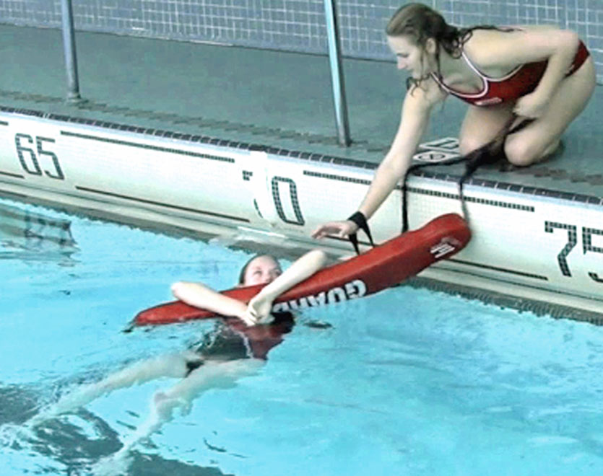
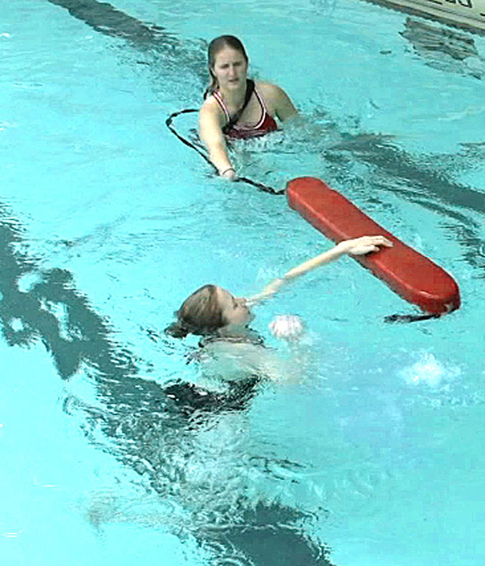
Pool Extraction
  Requires special consideration
    Aid provider should be able to swim or have water safety/lifeguard training
    Rescue tube should always be available
  Following procedures should be utilized
    For minor injuries, with patient close to pools edge, rescue tube can be used
    If far from edge entering the water will be necessary
Figure 12-30

Slide 35
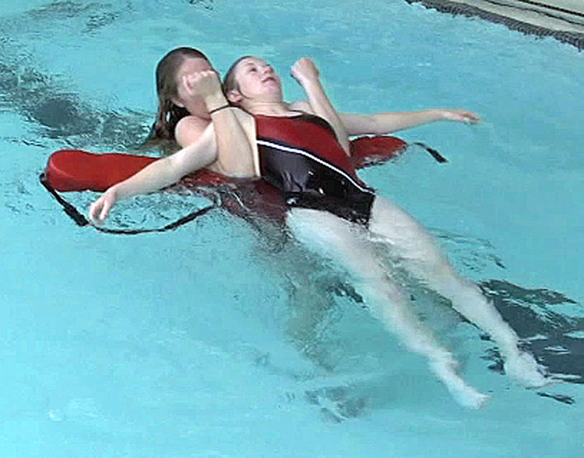
    When no injuries to head or neck, approach athlete from behind, reach under arm pits and use rescue tube (between swimmer and clinician)
      Tube can be used to help support swimmer
      Must keep swimmer calm while moving towards edge of pool
    Prior to removing swimmer from water you must consider level of assistance, size of swimmer, need for CPR
    If swimmer must come out of the water a spine board should be utilized
      Will require spine board and 2 rescuers
Figure 12-31

Slide 36
  Swimmer with suspected head or neck injury requires special consideration
    Must be approached in the water slowly not to disrupt water
    A single rescuer can stabilize the head and neck
      Place the arms of the swimmer overhead and compress against the head
      Stabilizes the head and neck
    Swimmer should be secured to spine board in water while stabilization is maintained
    Once on board, swimmer should be stabilized and when removed from the pool, it should occur head first

Slide 37
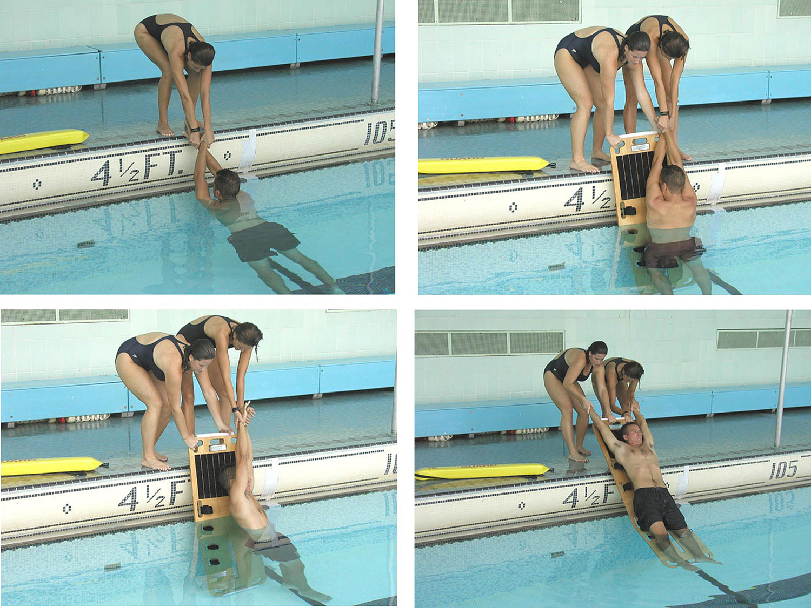
Figure 12-32

Slide 38
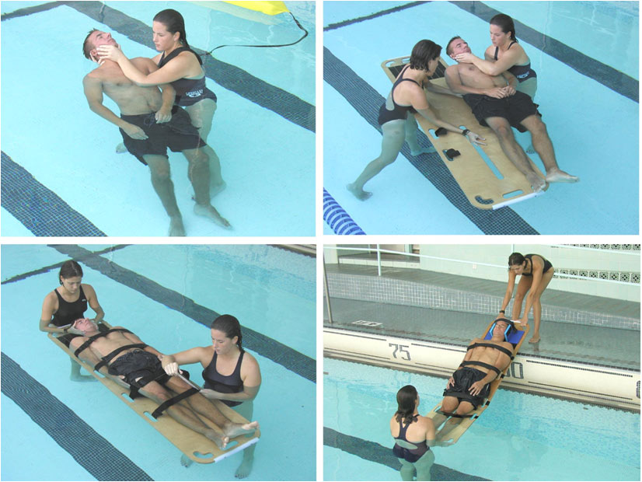

Slide 39
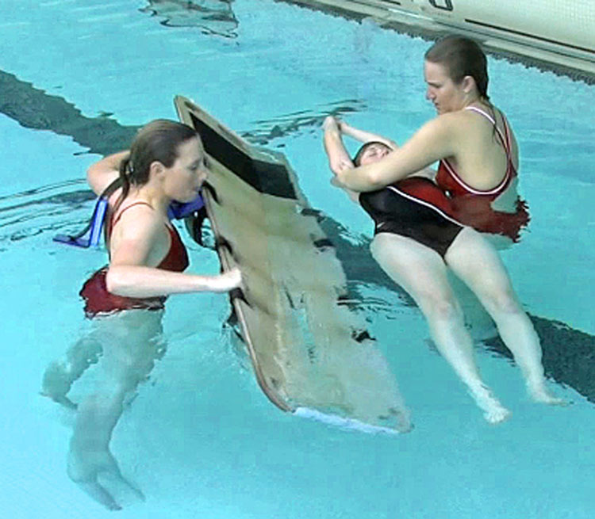
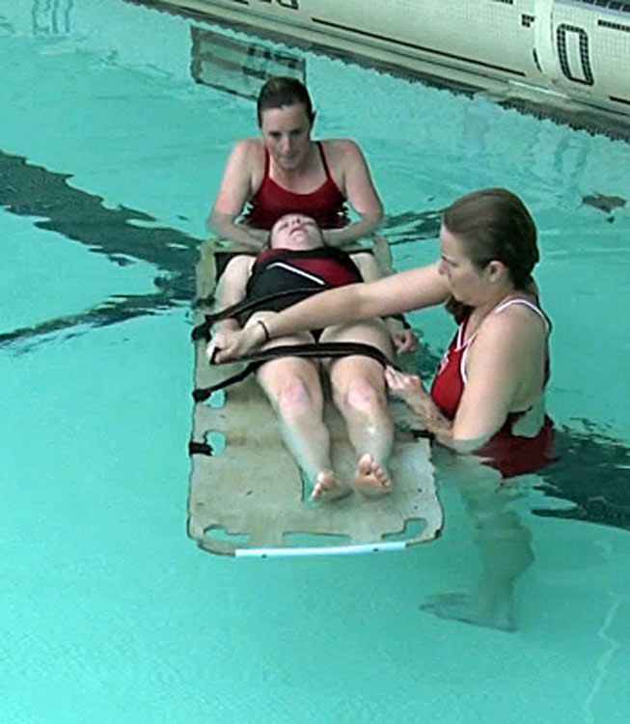
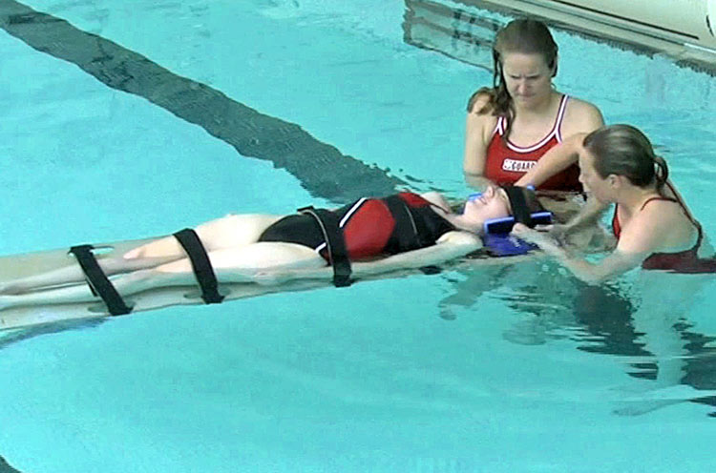
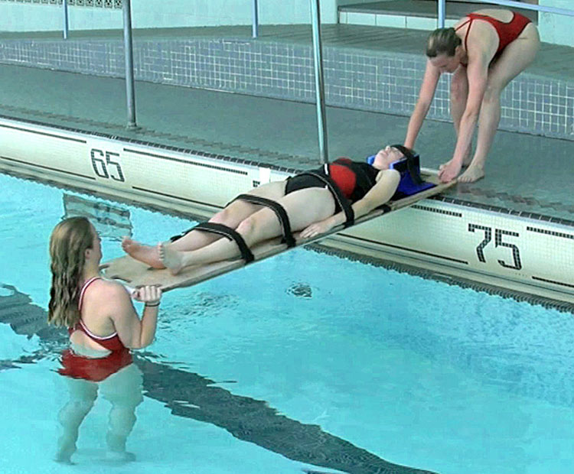
Figure 12-33

